Slide 1
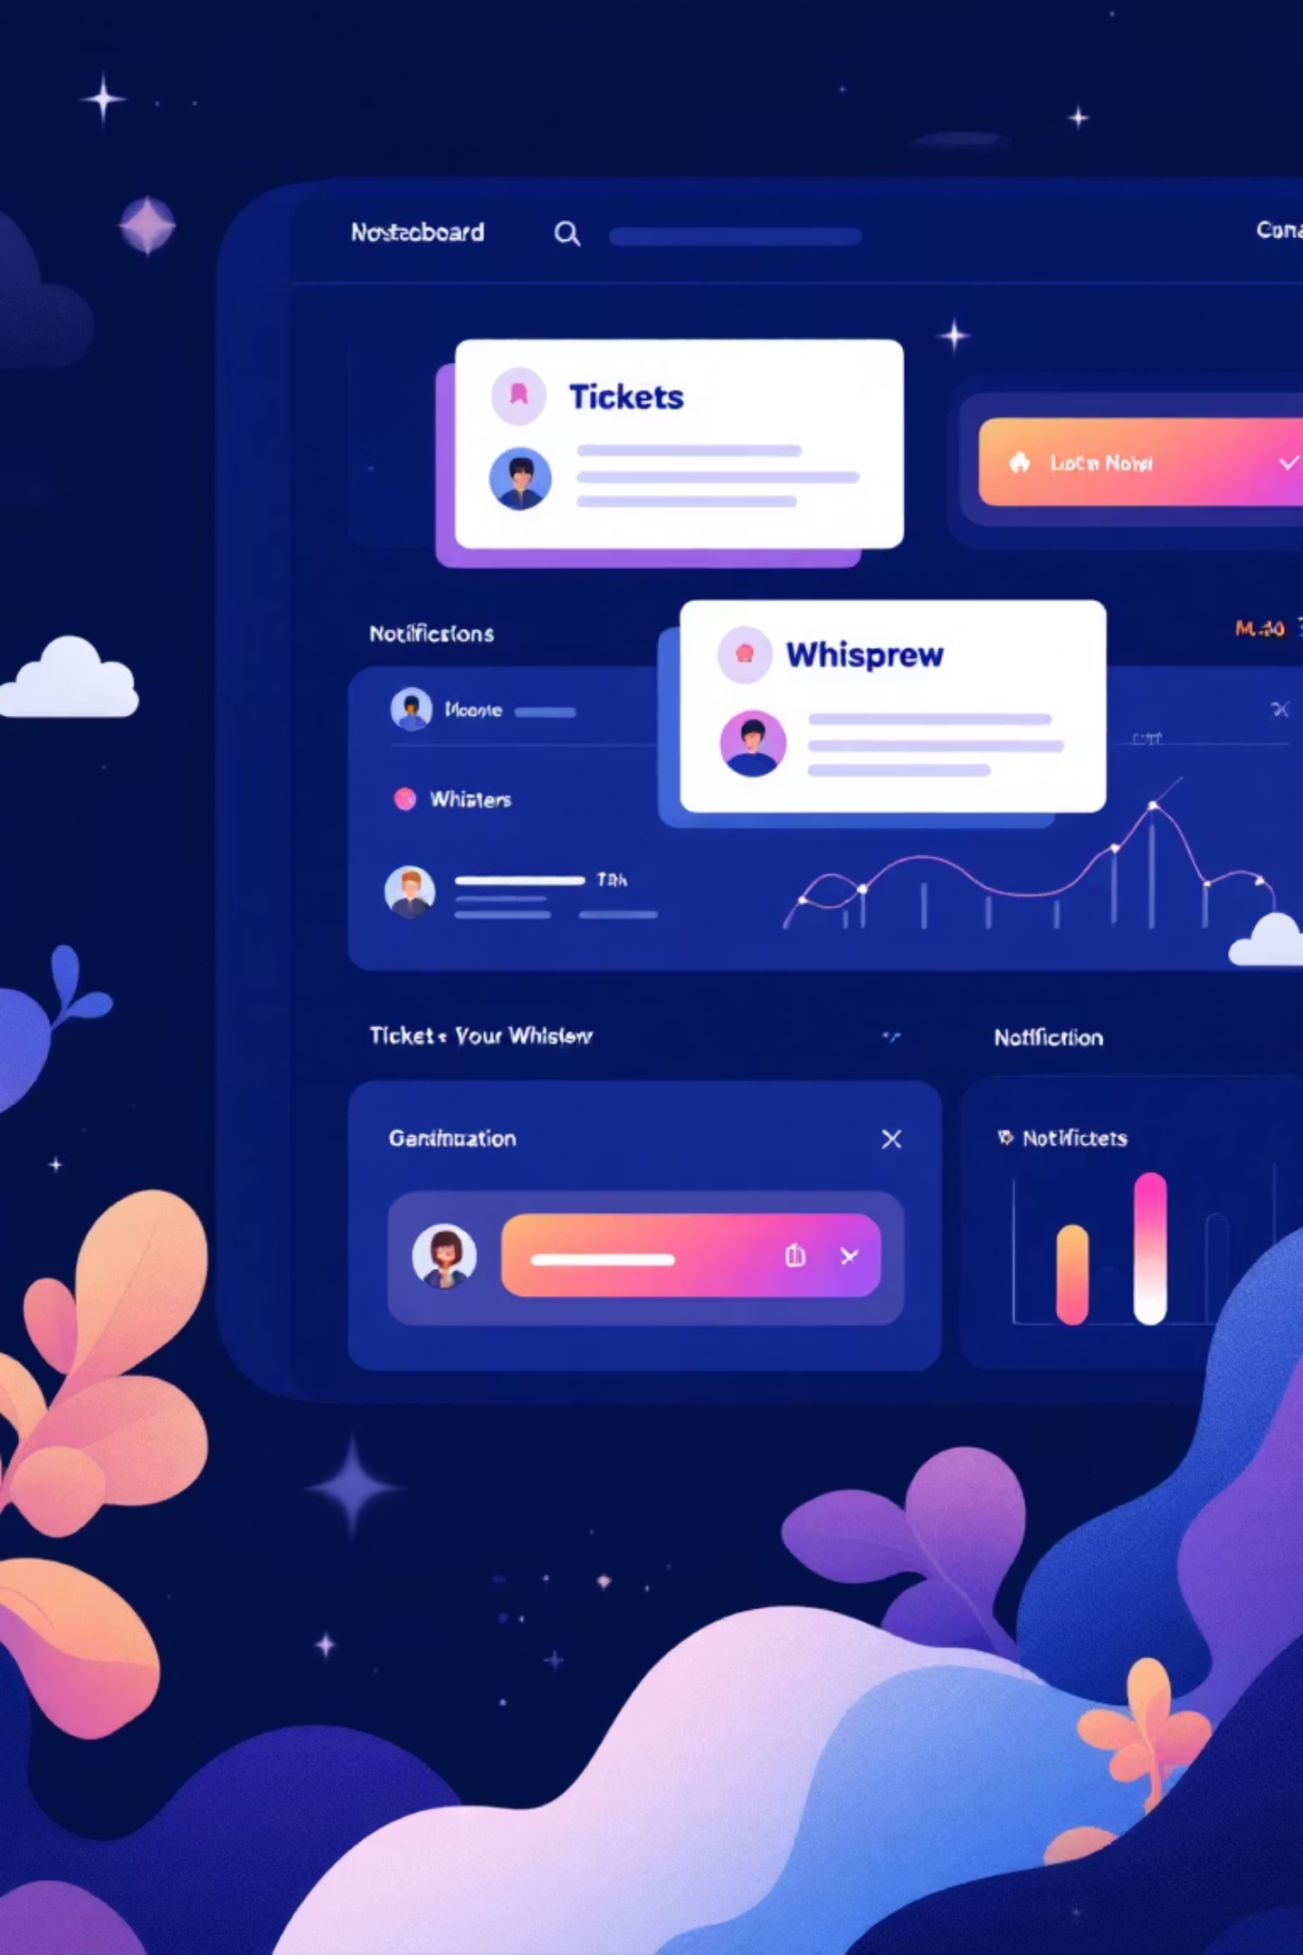




Smart Ticket & Issue Management System
An enterprise-grade, microservices-based system designed to streamline support operations through intelligent automation and real-time collaboration.
SPRING BOOT
MONGODB
MICROSERVICES
JWT SECURITY
Name : A.Sreenidhi

Slide 2


PROBLEM STATEMENT
Many organizations still rely on emails and spreadsheets to manage IT support tickets, leading to fragmented tracking and inefficient coordination.
There is no centralized system to monitor ticket status, priority, assignment, escalation, or SLA compliance.
Current Pain Points
Manual ticket routing causes delays and operational bottlenecks
No intelligent load balancing among support agents
Inconsistent data handling across ticket lifecycle states
Limited visibility into ticket ownership and authorization

Slide 3





Project Objectives & Goals
Intelligent Automation
Enhanced Security
Implement smart auto-assignment with load awareness to optimize agent workload distribution and reduce manual routing overhead.
Build robust ownership-based authorization with role-based access control ensuring secure, compliant ticket operations.
Lifecycle Management
Scalable Architecture
Enforce state-dependent field validation rules that maintain data integrity throughout the ticket lifecycle.
Design microservices-based system architecture enabling independent scaling, deployment flexibility, and high availability.

Slide 4
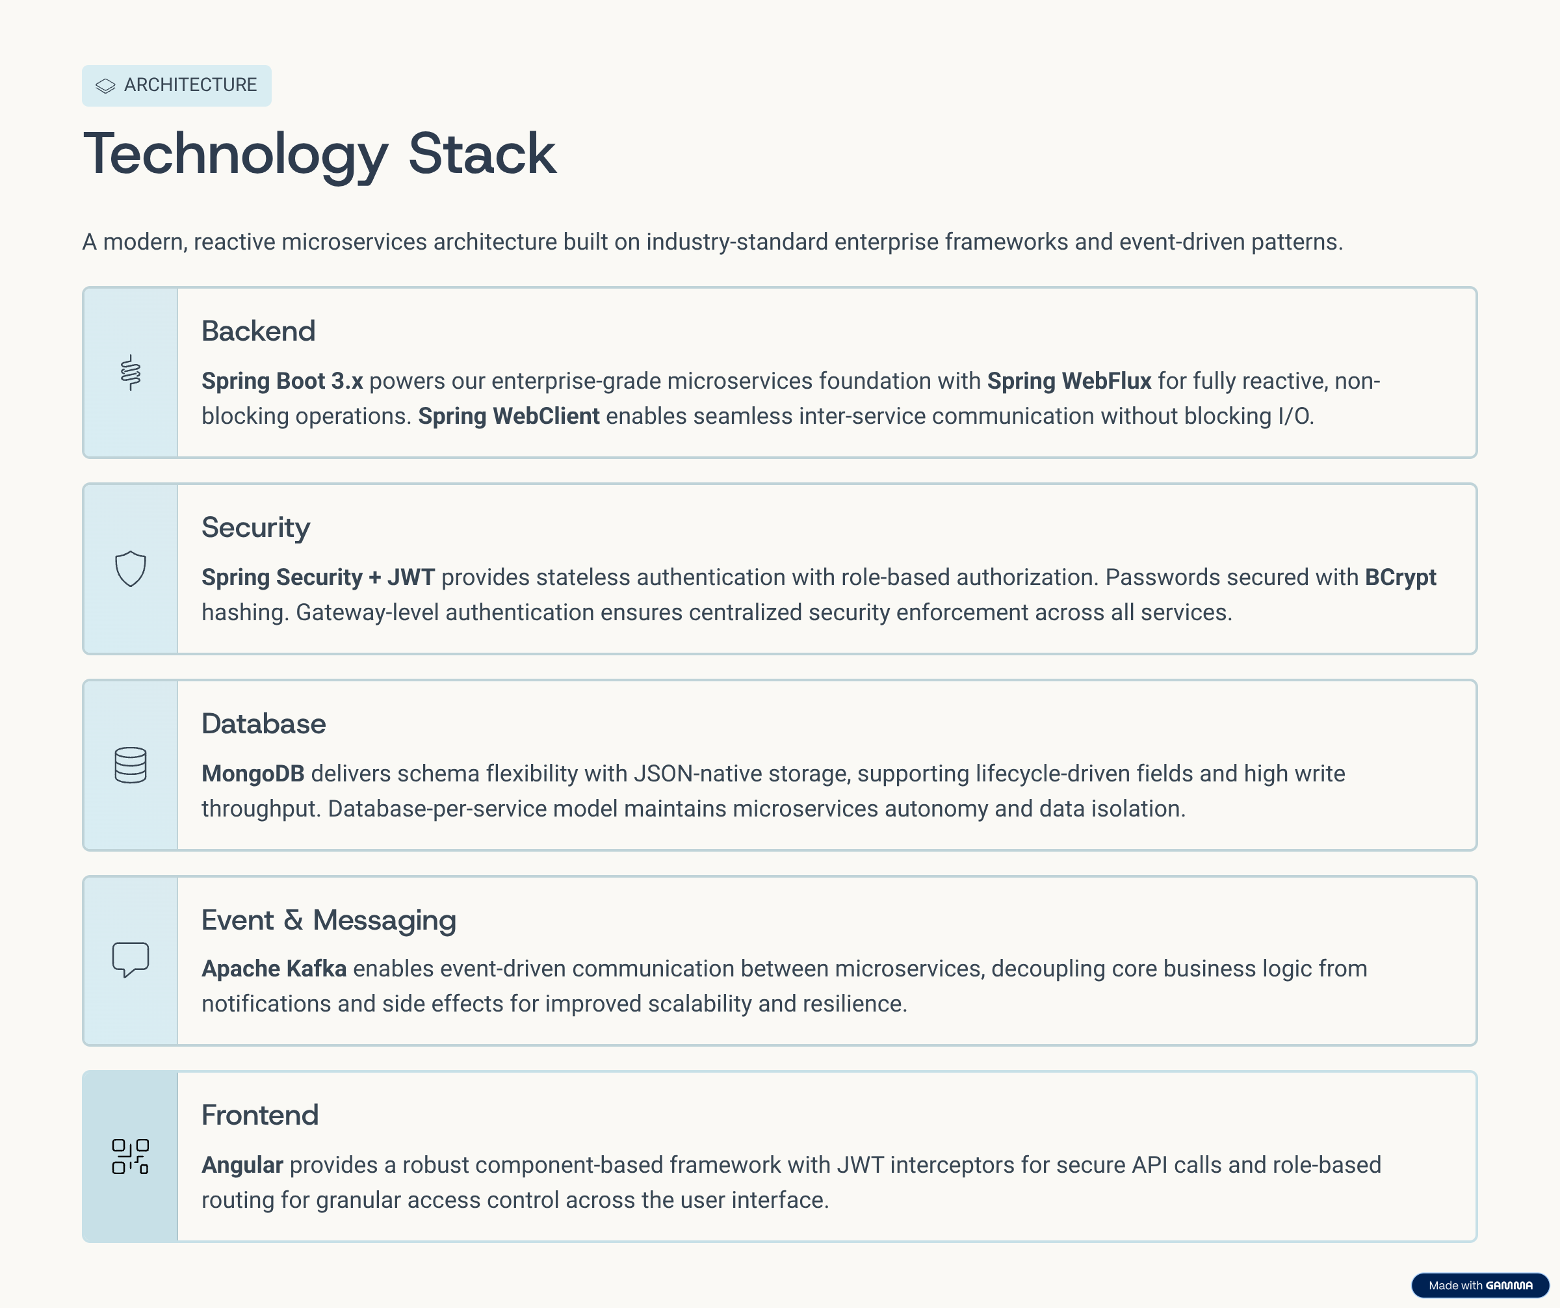



Slide 5






High-Level System Architecture
API Gateway
Centralized entry point handling authentication, routing, and rate limiting
Core Microservices
Independent services for tickets, users, assignments, and notifications
Event Bus
Asynchronous event-driven communication enabling real-time updates
The architecture leverages Spring Boot microservices communicating through reactive WebClient, orchestrated by an API gateway. Event-driven design ensures loose coupling and enables real-time notifications across the system.

Slide 6
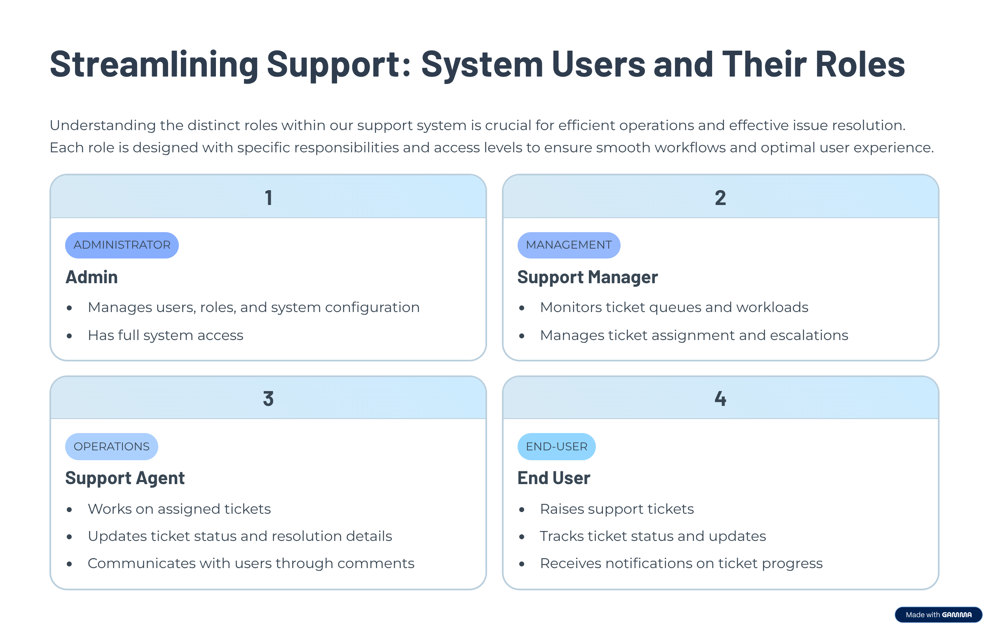



Slide 7
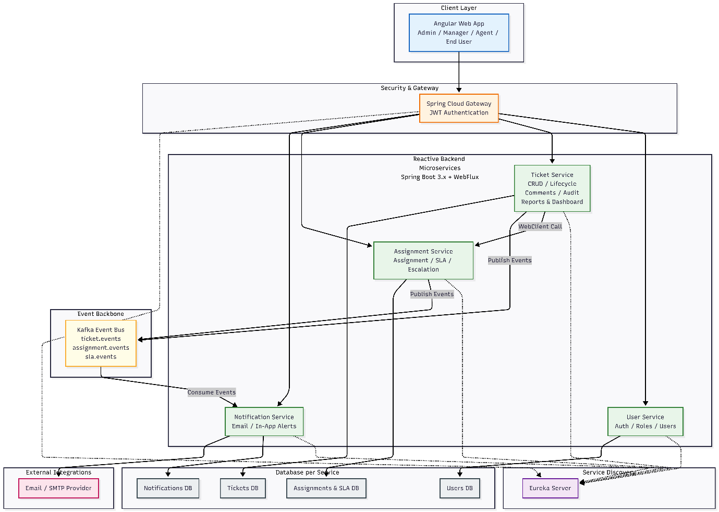

Microservices Architecture

Slide 8
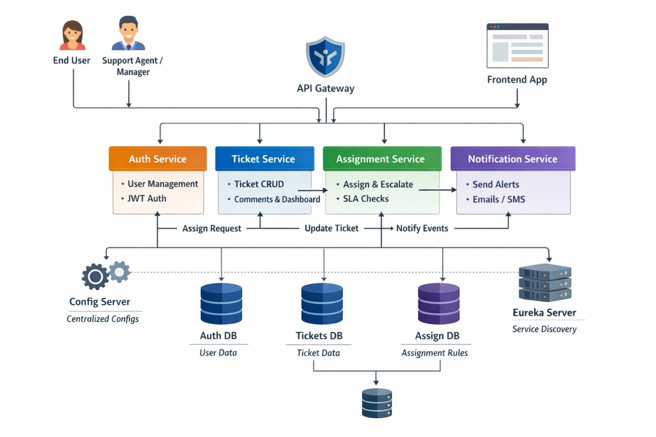

Slide 9
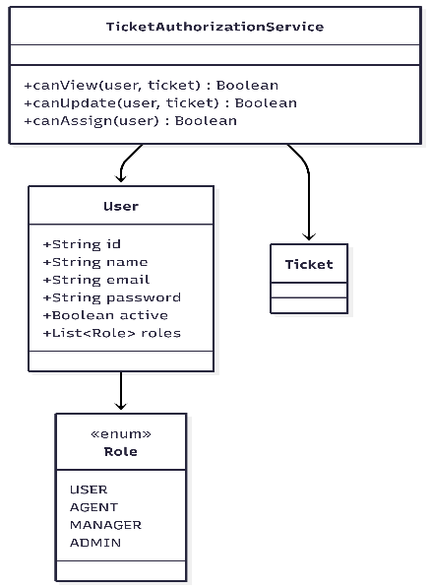
CLASS DIAGRAMS
1)User:

Slide 10
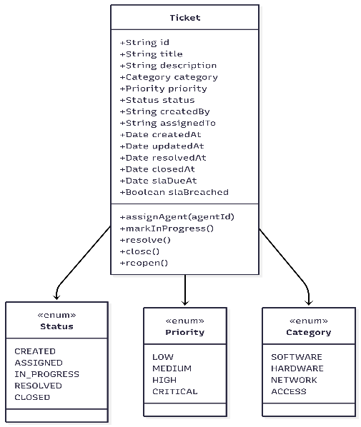
2)Ticket

Slide 11
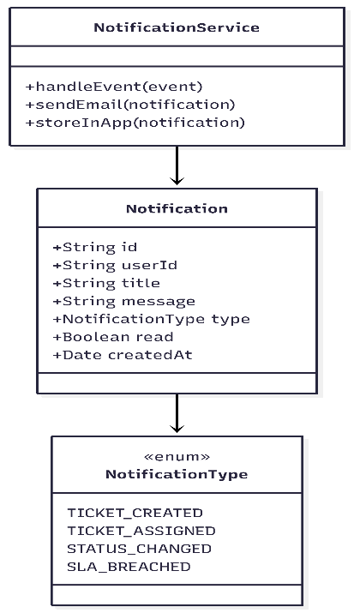
3)Notification:

Slide 12
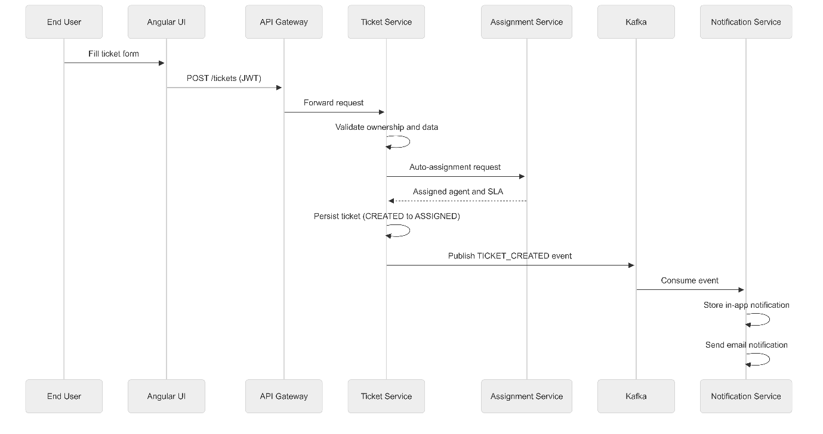
SEQUENCE DIAGRAMS
1)USER CREATES A TICKET

Slide 13
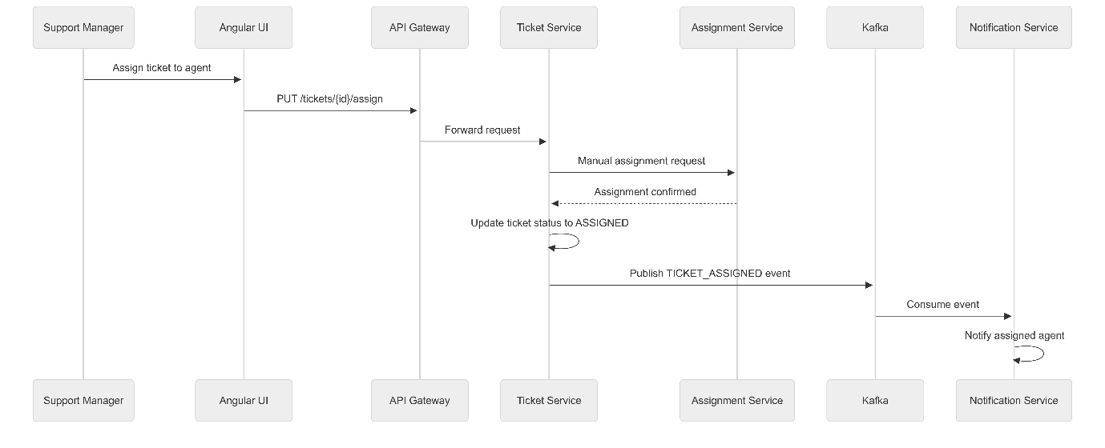
2) SUPPORT MANAGER MANUALLY ASSIGNS TICKET

Slide 14
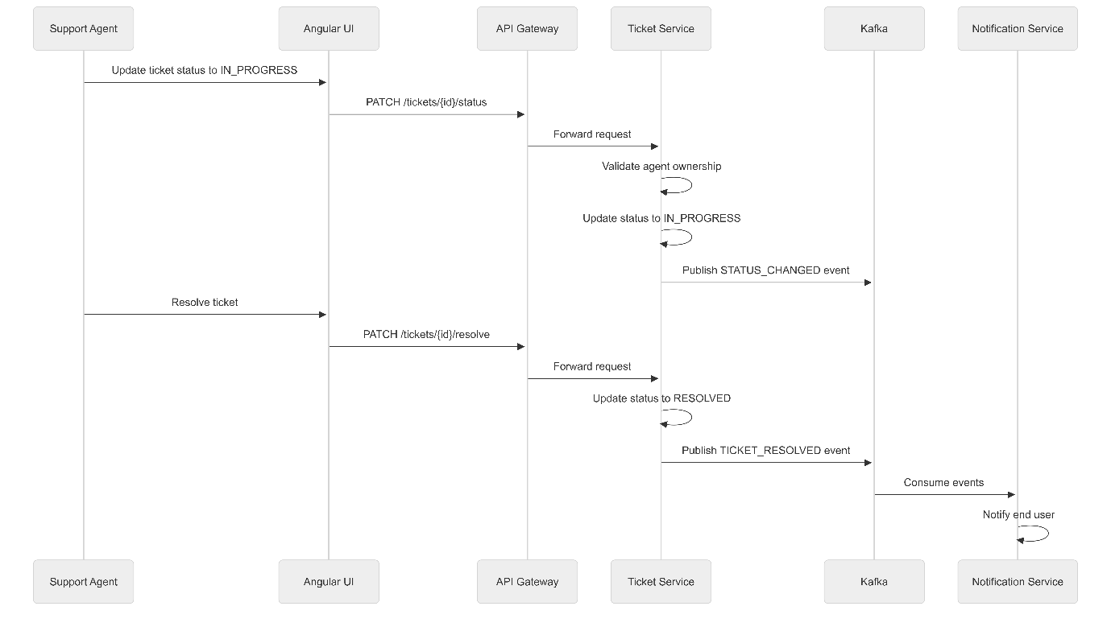
3) SUPPORT AGENT WORKS & RESOLVES TICKET

Slide 15
4.Complete flow:

Slide 16
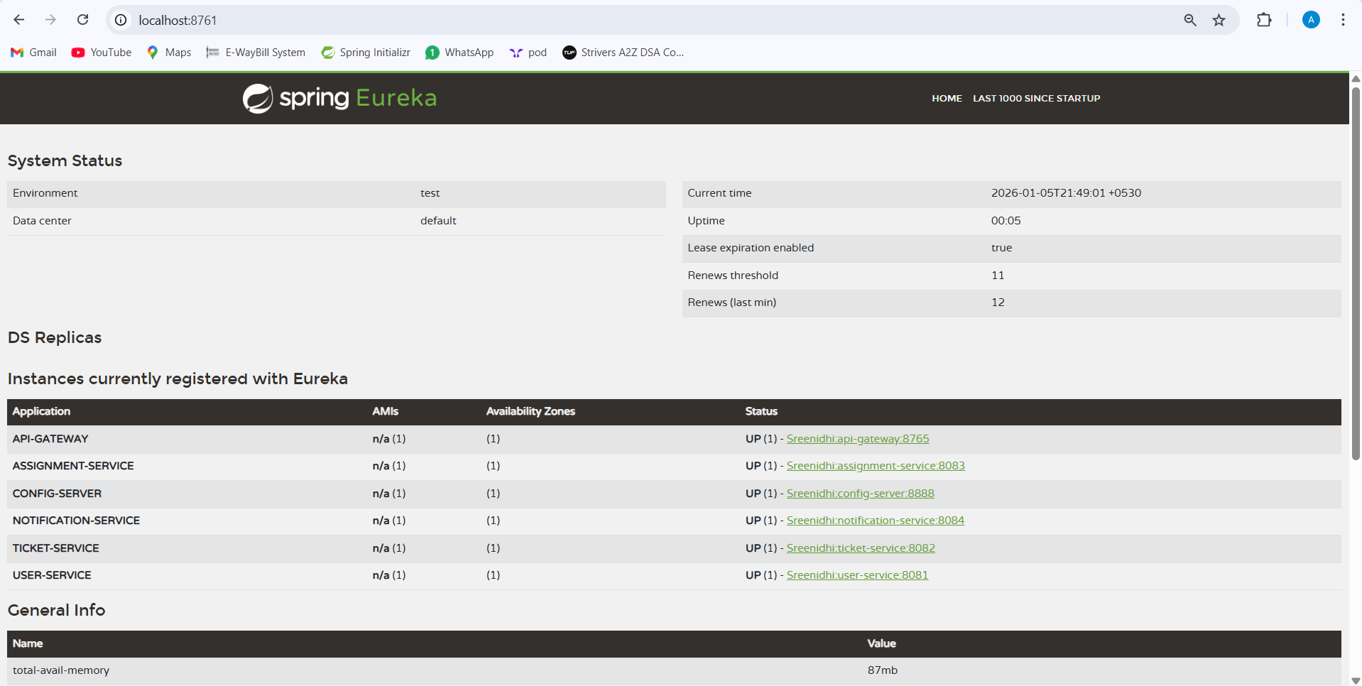
Eureka Server

Slide 17
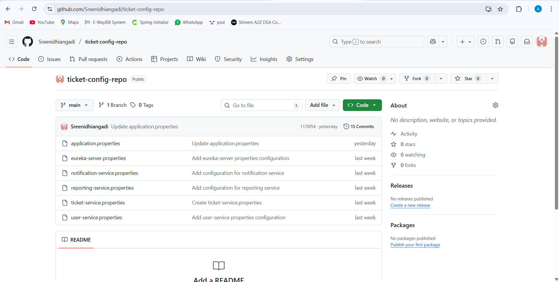
Config server Repository: link :https://github.com/Sreenidhiangadi/ticket-config-repo

Slide 18
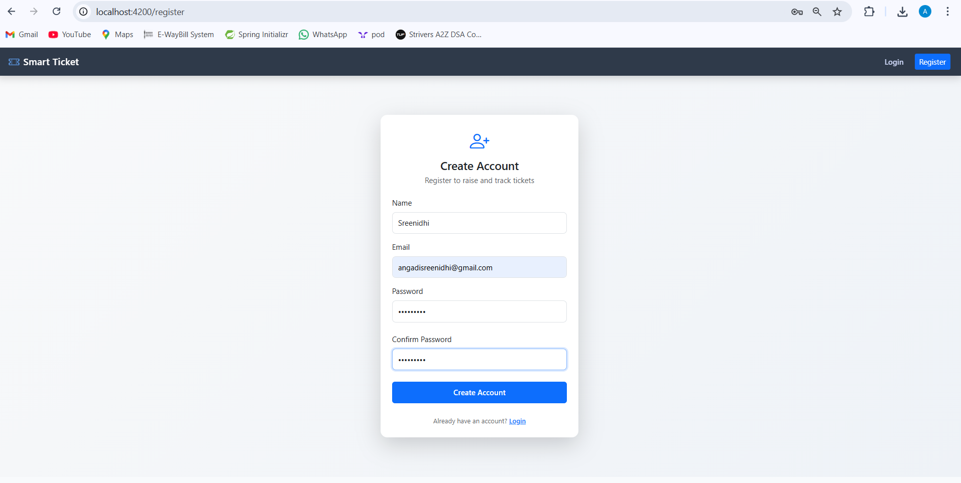
Implemenation Screenshots
1.Register(Successful registration redirects to login)

Slide 19
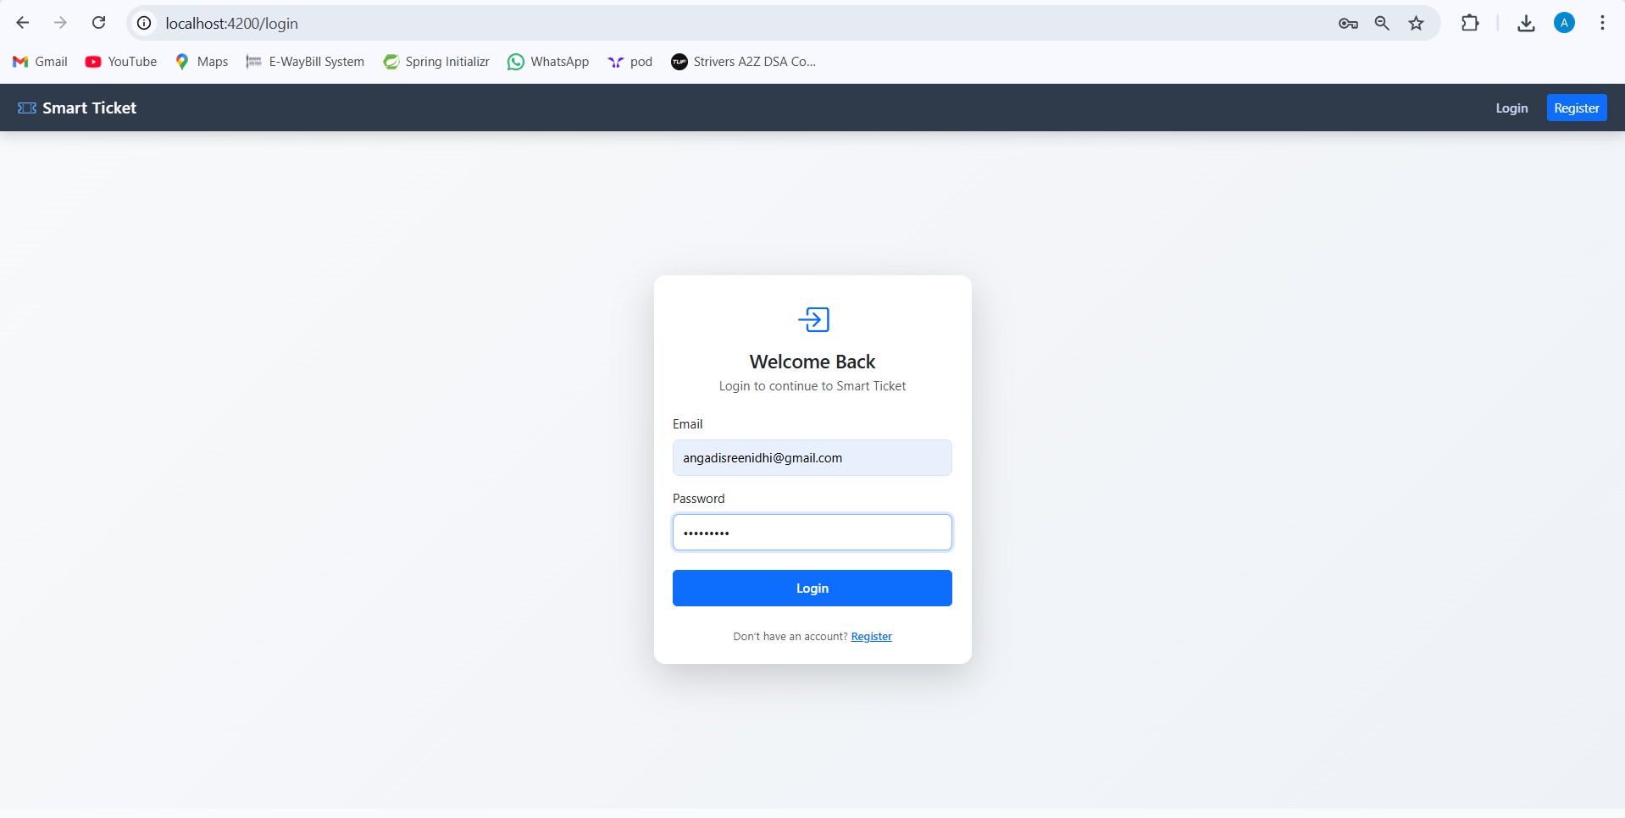
2.Login

Slide 20
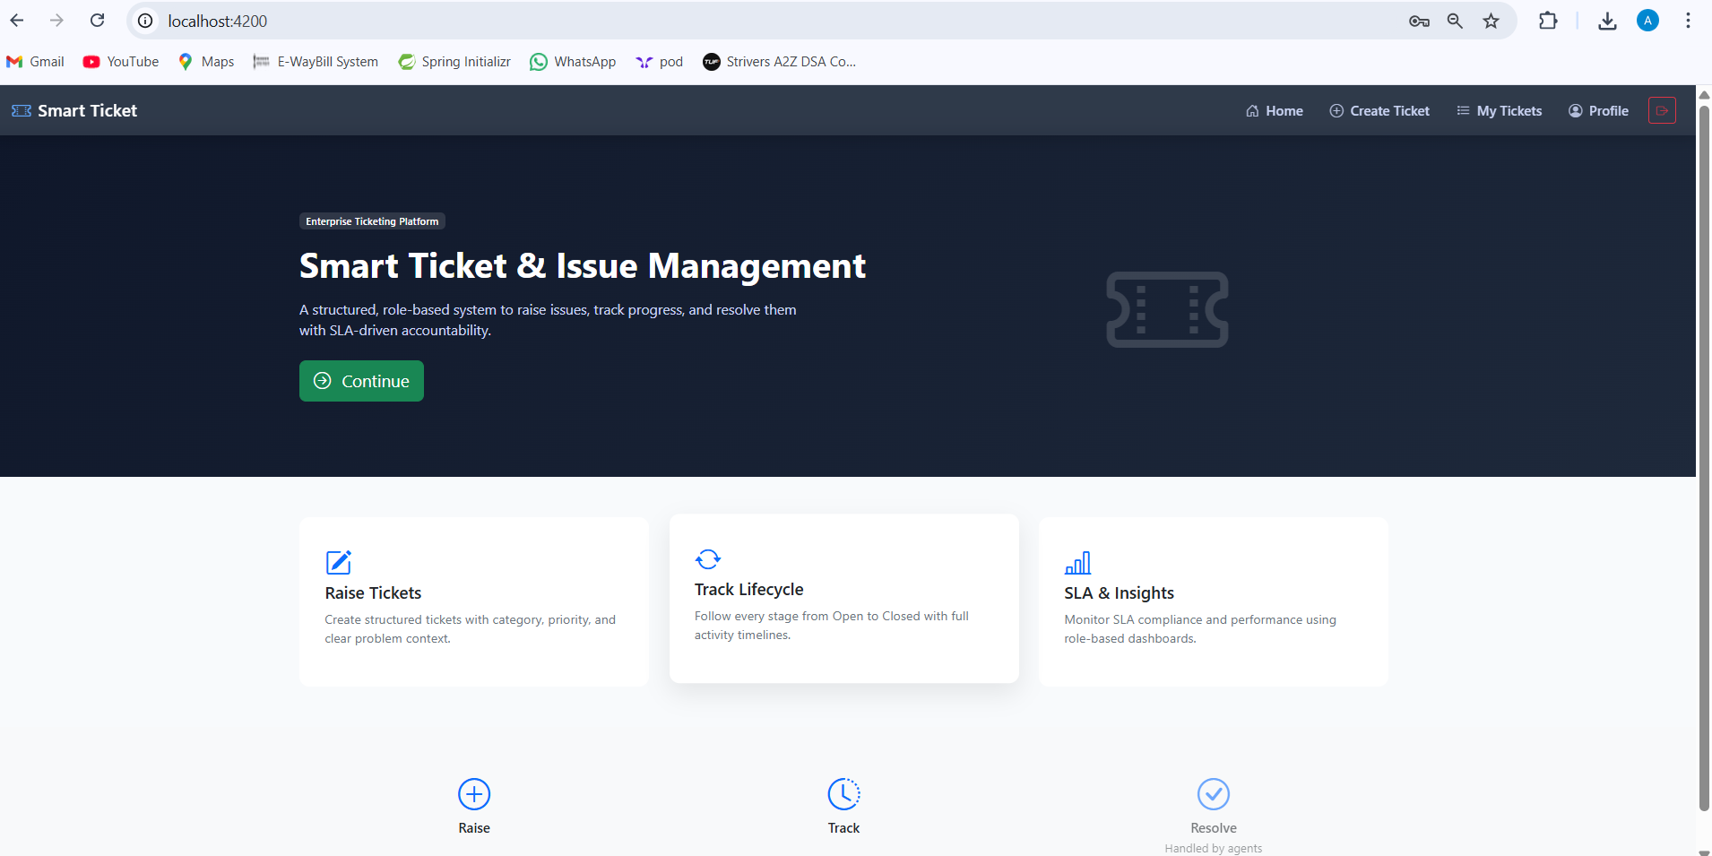
Role:User
3.Home Page

Slide 21
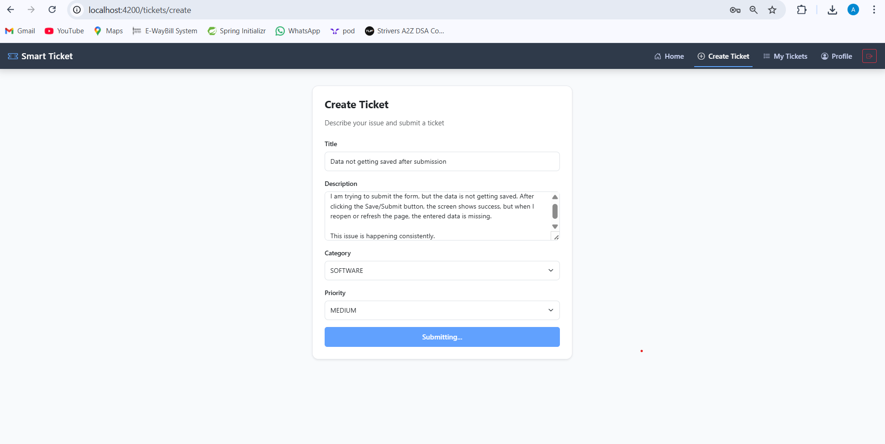
3.Create a Ticket

Slide 22
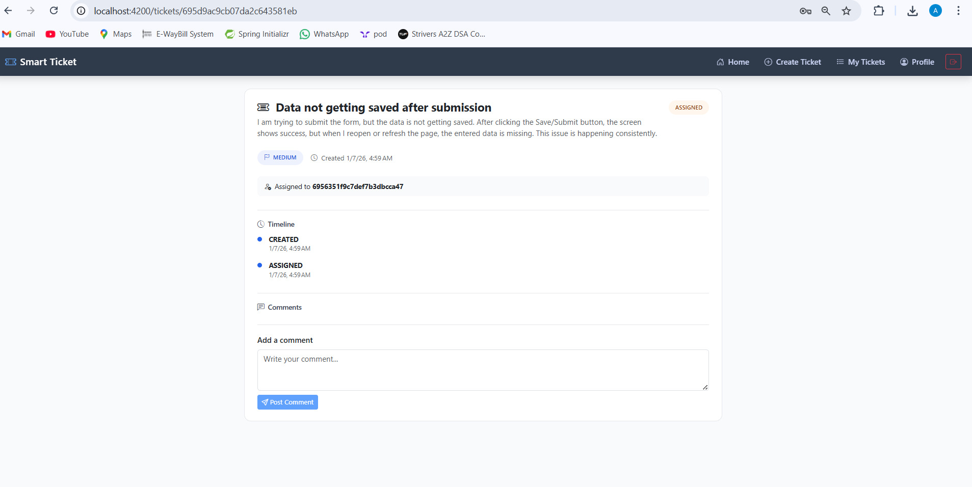
4.Ticket Details

Slide 23
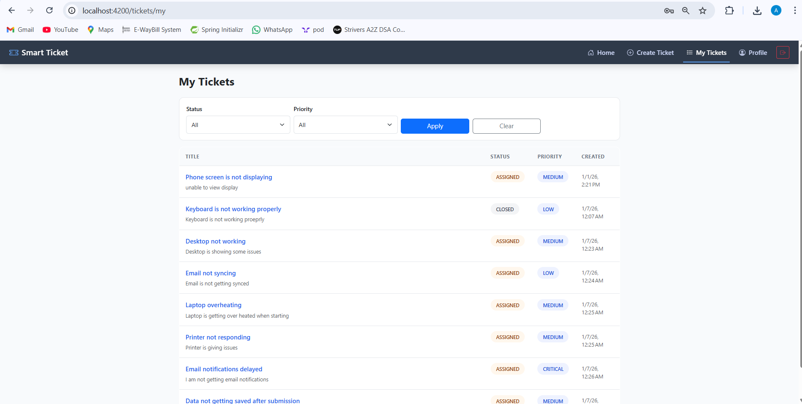
5.User Tickets with filtering

Slide 24
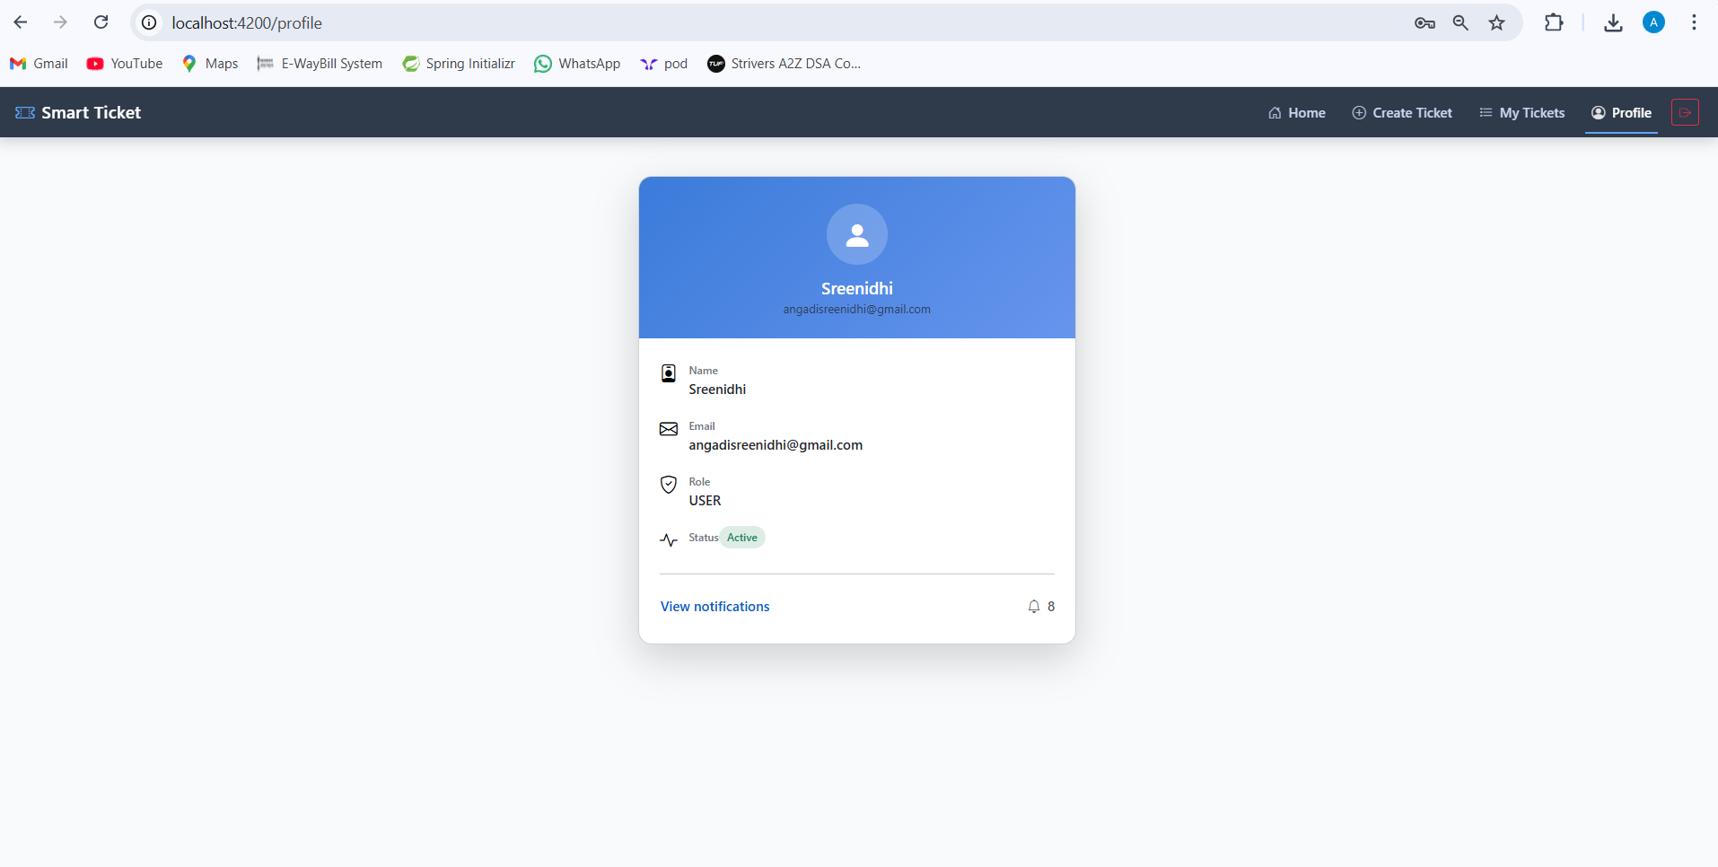
6.Profile page

Slide 25
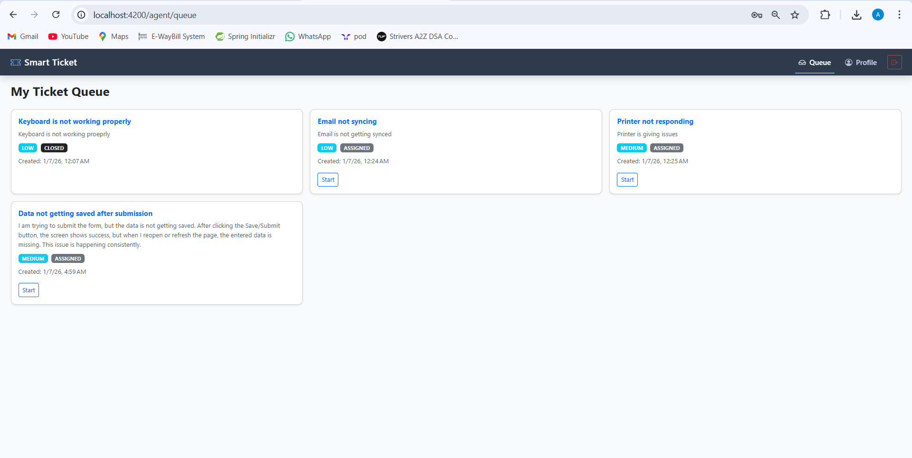
Role:Agent
7.Ticket Queue

Slide 26
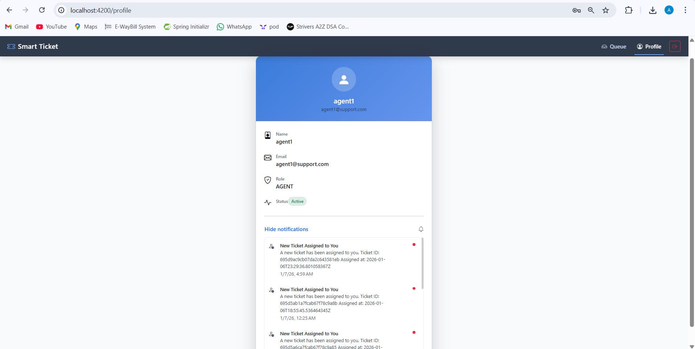
8.Agent profile with in app notifications

Slide 27
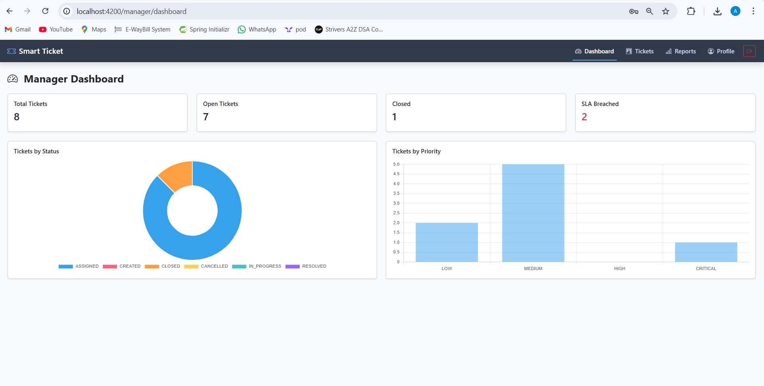
Role:Manager
9.Dashboard

Slide 28
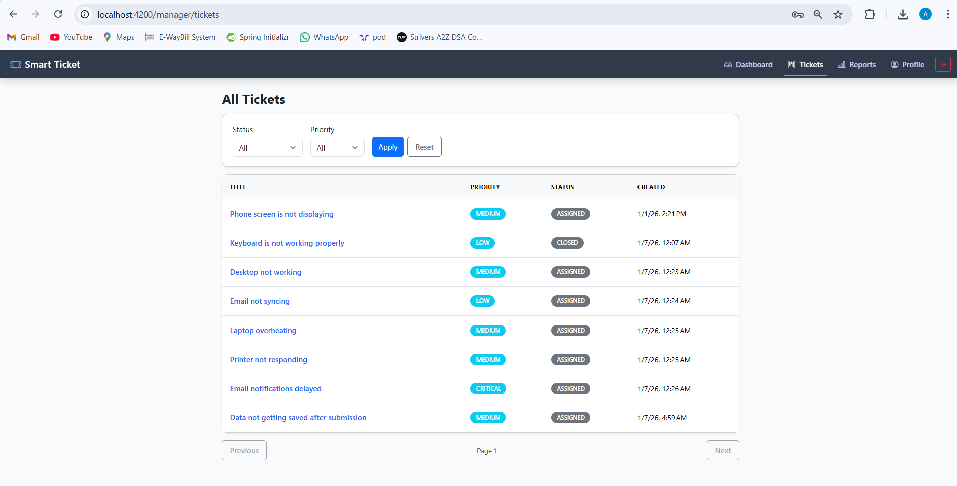
10.All tickets( with pagination + filtering)

Slide 29
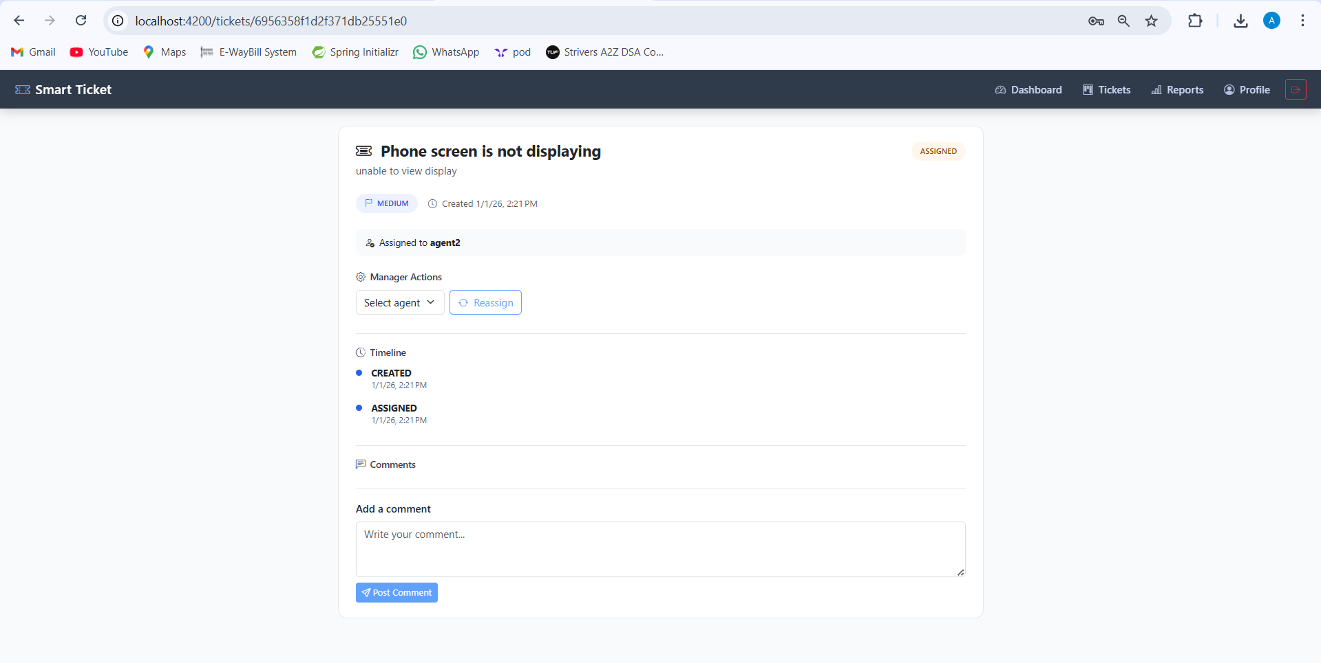
11.Manager actions(reassigning)

Slide 30
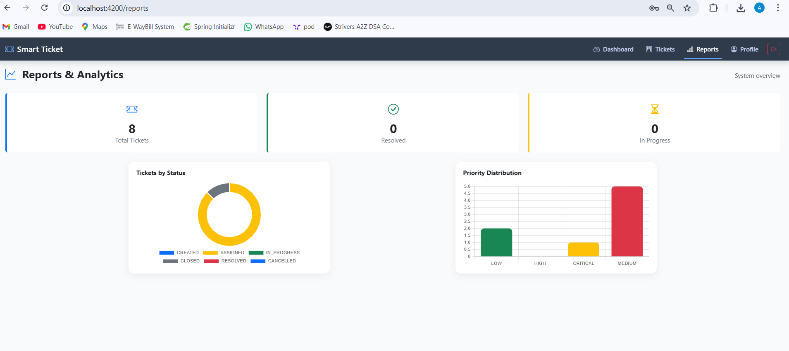
12.Reports and Analytics

Slide 31
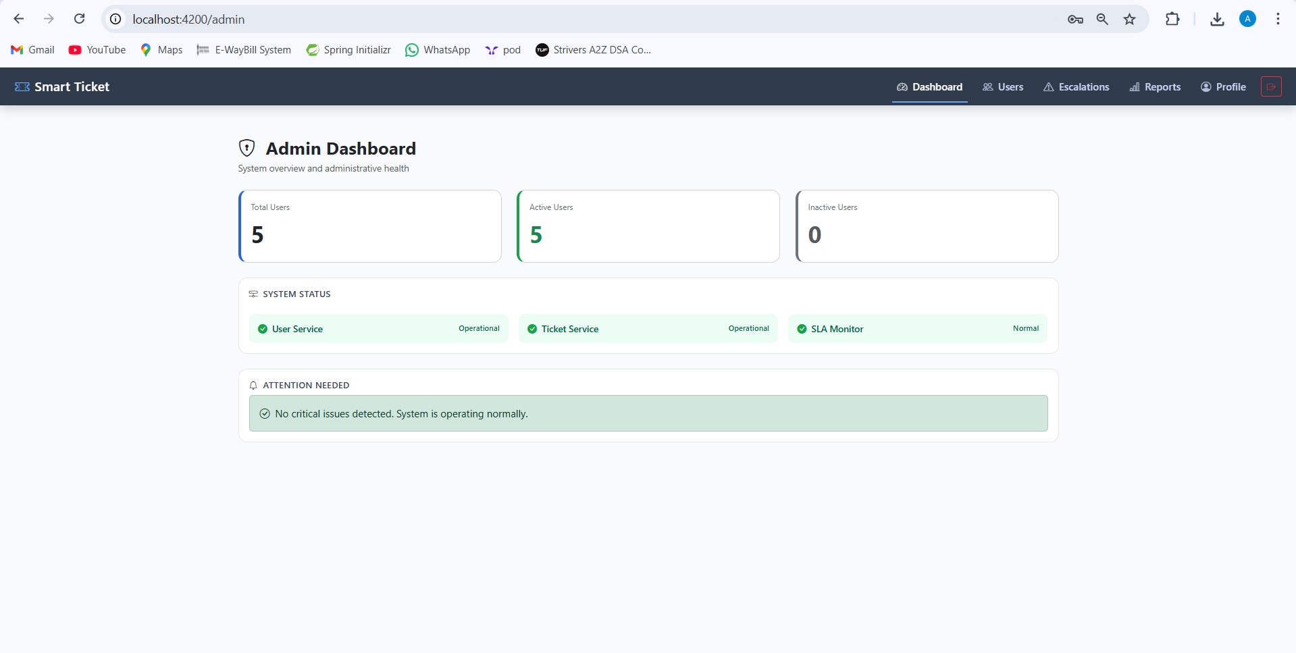
Role : Admin
13.Admin Dashboard

Slide 32
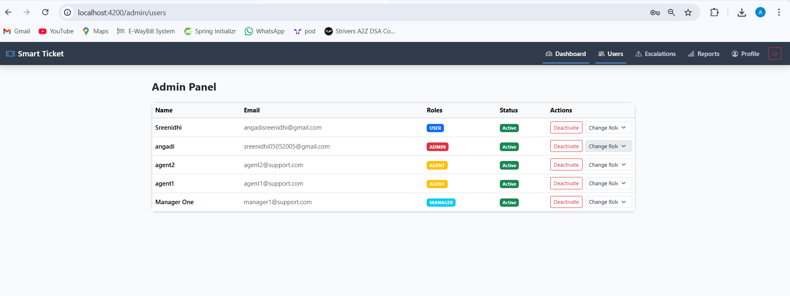
14.Admin Panel

Slide 33
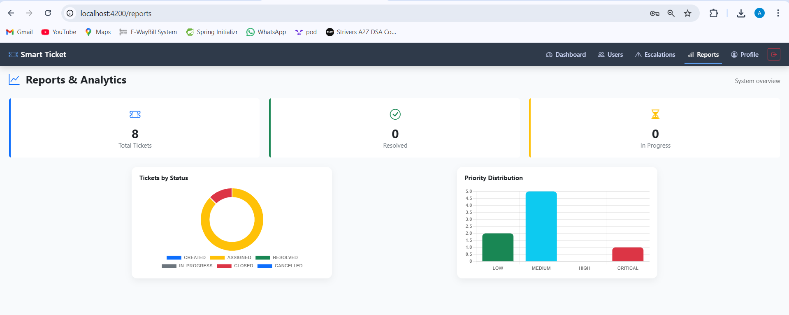
15.Reports and Analytics

Slide 34
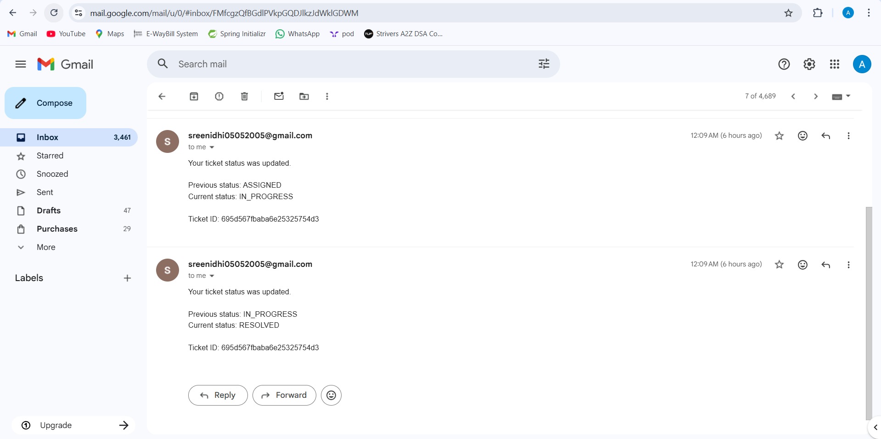
16)Email Notifications

Slide 35
End-to-End Ticketing System Flow (UI + Roles)
1. User Registration & Login
User registers with email and password
User logs into the system
User lands on the User Dashboard
2. User Creates a Ticket
User clicks Create Ticket
User selects:
Issue category
Priority
Description
User submits the ticket
Ticket status is set to Open
3. User Adds Comments (Optional)
User can add comments or attachments
Each comment is added to the ticket timeline
User can track ticket status anytime
4. Auto Assignment to Agent
System automatically assigns the ticket to an available Agent
Assignment is based on:
Category
Workload
Availability
Agent is notified immediately
5. Agent Works on the Ticket
Agent views assigned tickets in Agent Dashboard
Agent:
Reviews issue details
Adds internal or public comments
Changes ticket status (In Progress / Waiting / Resolved)
6. User Notifications
User receives notifications when:
Ticket is assigned
Agent adds a comment
Status changes
Ticket is resolved
Notifications can be email or in-app.
7. Manager Oversight
Manager views all tickets
Manager can:
Reassign tickets to different agents
Change ticket priority
Reopen resolved tickets if needed
Monitor SLA and response time

Slide 36
8. Ticket Resolution
Agent marks ticket as Resolved
User is notified
User can:
Accept the resolution → ticket closed
Reopen the ticket if issue persists
9. Admin Role Management
Admin manages users and roles
Admin can:
Create users
Assign roles (User / Agent / Manager / Admin)
Activate or deactivate accounts
Configure categories and rules

Slide 37
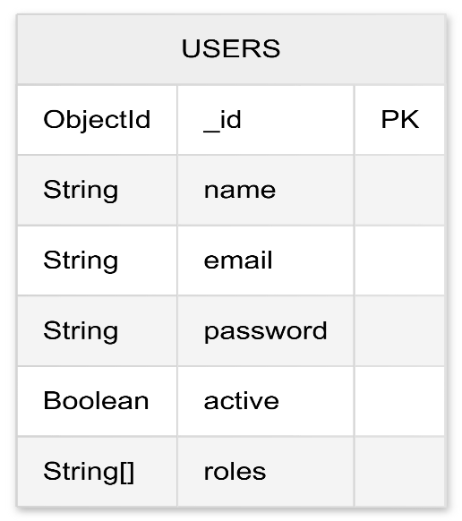
DATABASE STRUCTURE
1) User db:

Slide 38
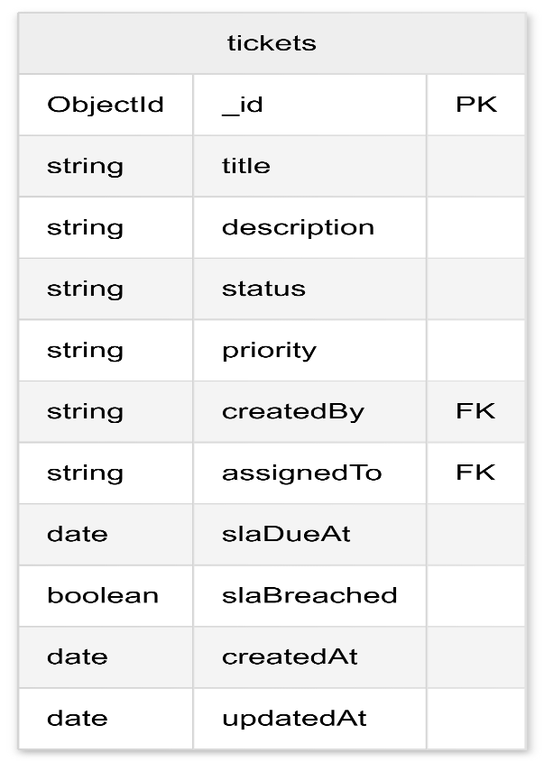
2)Ticket db:

Slide 39
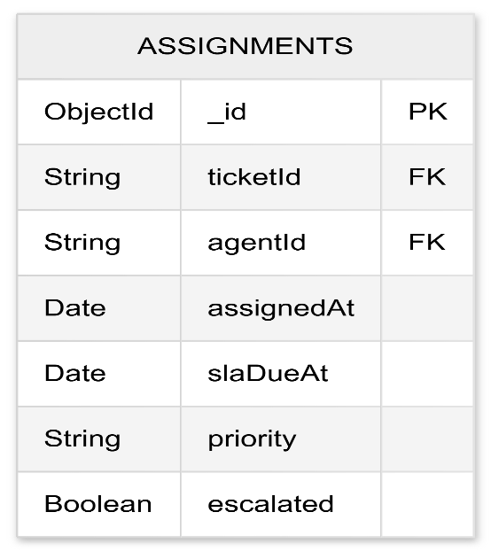
3)Assignment db

Slide 40
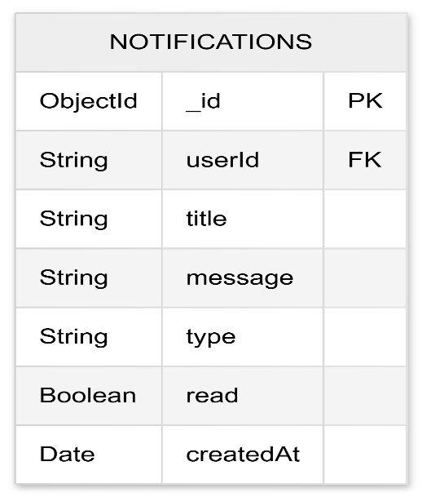
4)Notification db

Slide 41
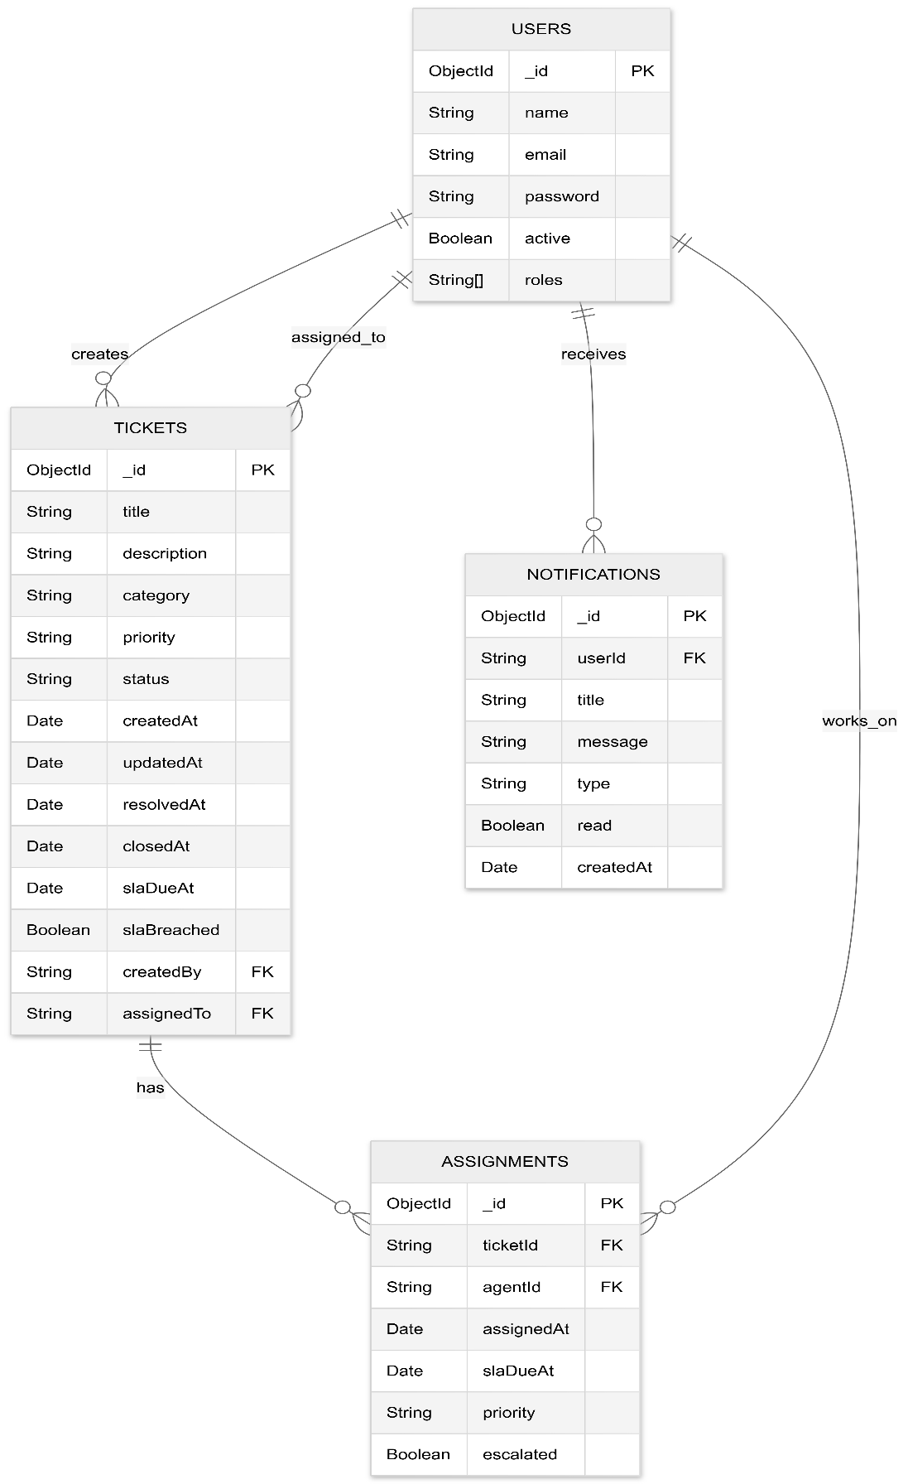
5)Complete db structure:

Slide 42




Why MongoDB for Backend Storage?
01
Schema Flexibility
Tickets evolve with varying field requirements across states. MongoDB's document model allows dynamic schemas without costly migrations, perfect for agile development.
02
Microservices Alignment
Each microservice maintains its own MongoDB instance, ensuring database-per-service pattern. This enables independent scaling and eliminates tight coupling.
03
JSON-Native Storage
REST APIs naturally work with JSON. MongoDB stores data as BSON, eliminating object-relational impedance mismatch and reducing serialization overhead.
04
Horizontal Scalability
Built-in sharding and replication support high-volume ticket operations, ensuring system remains responsive during peak loads and providing high availability.

Slide 43



WebClient Over Feign: Reactive Communication
Why WebClient?
Non-Blocking I/O
Reactive streams enable handling thousands of concurrent requests without thread exhaustion.
Backpressure Support
Prevents overwhelming downstream services during high-load scenarios with built-in flow control.
Modern Async Patterns
Mono and Flux types provide composable, declarative asynchronous programming model.
Performance at Scale
Better resource utilization and lower latency compared to traditional blocking approaches.
Technical Decision: While Feign offers simplicity, WebClient's reactive capabilities align with our high-throughput requirements and Spring's modern reactive ecosystem.

Slide 44


BUSINESS LOGIC
Core Business Rules Implemented
1
2
3
Lifecycle-Driven Field Validity
Ownership-Based Authorization
Auto-Assignment with Load Awareness
State-dependent validation ensures required fields are enforced based on ticket status, preventing invalid state transitions.
Combined RBAC and ownership checks ensure users can only modify tickets they own or have explicit permissions for.
Intelligent routing algorithm distributes tickets to available agents based on current workload, skills, and availability status.
These rules form the foundation of our ticket management logic, ensuring data integrity, security compliance, and operational efficiency throughout the system.

Slide 45


Business Rule 1: Lifecycle-Driven Field Validity
New
Resolved
Required: title, description, priority
Required: all previous + resolution notes
Assignment optional
Immutable fields locked
1
2
3
4
In Progress
Closed
Required: all New fields + assignee
Required: complete audit trail
Resolution details optional
No further modifications
Implementation Approach: State machines validate field presence and transitions at the service layer. Custom annotations on entity classes define state-specific constraints, enforced through Spring validation framework. Invalid transitions trigger descriptive error responses.

Slide 46
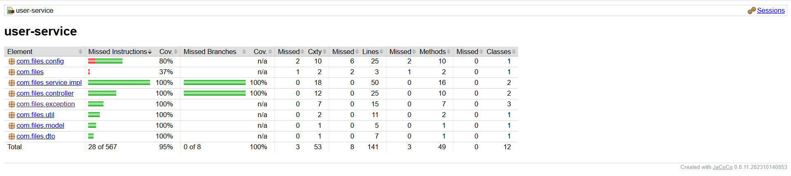
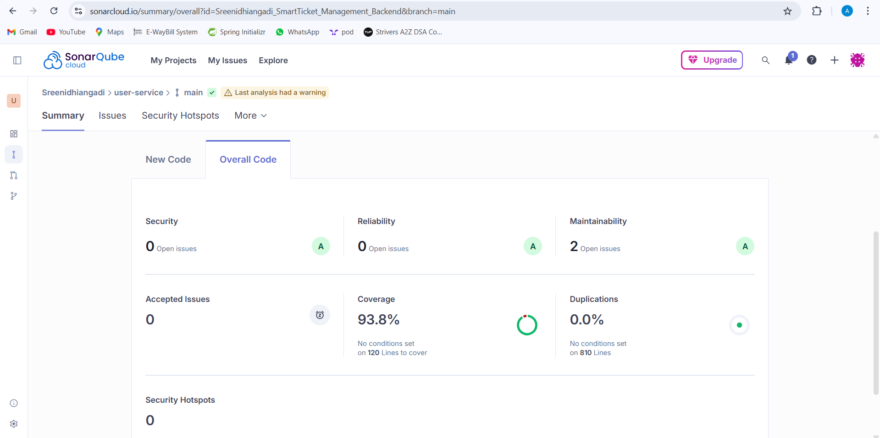
Sonar & Jacoco Reports
1.User Service

Slide 47
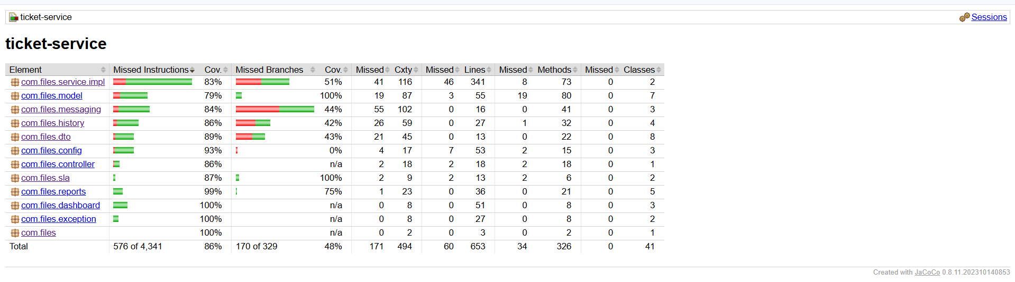
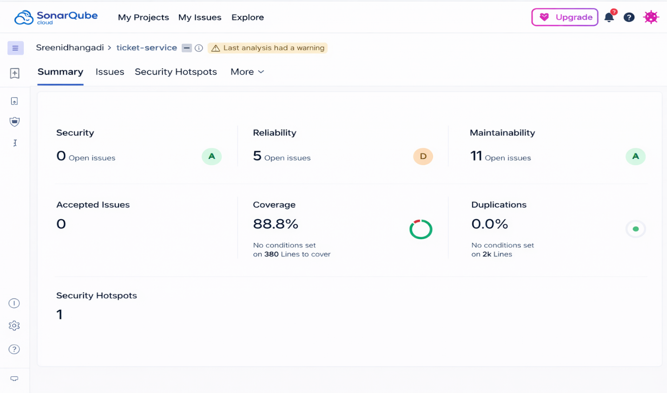
2.Ticket Service

Slide 48
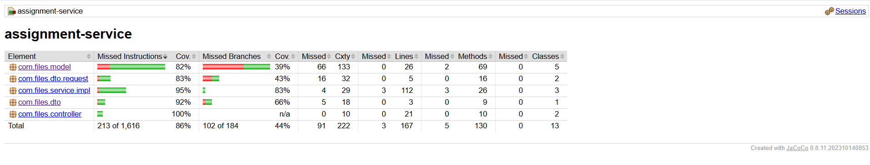
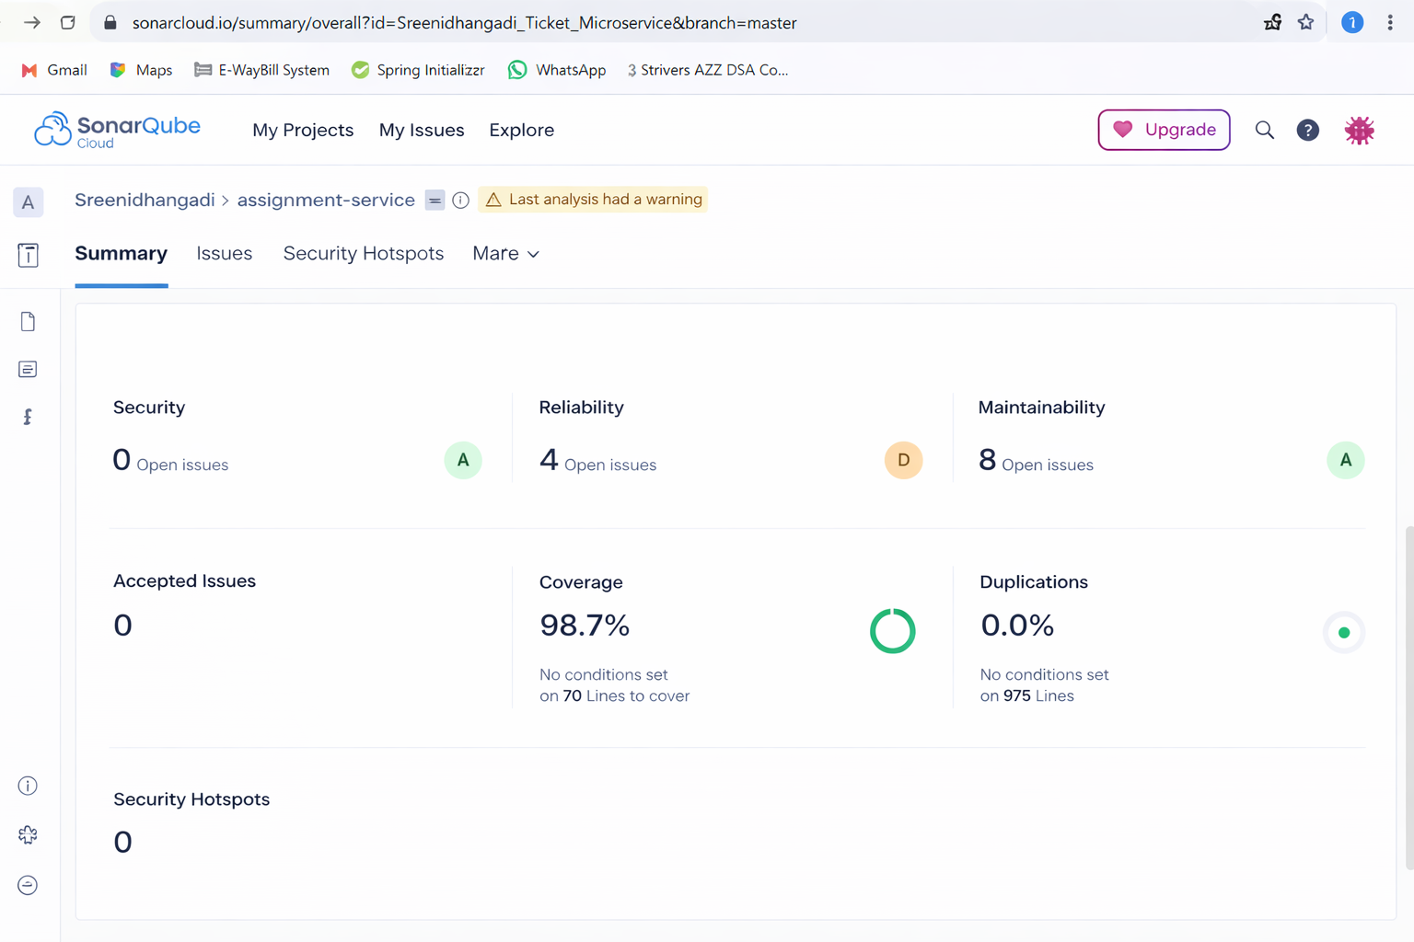
3.Assignment Service

Slide 49
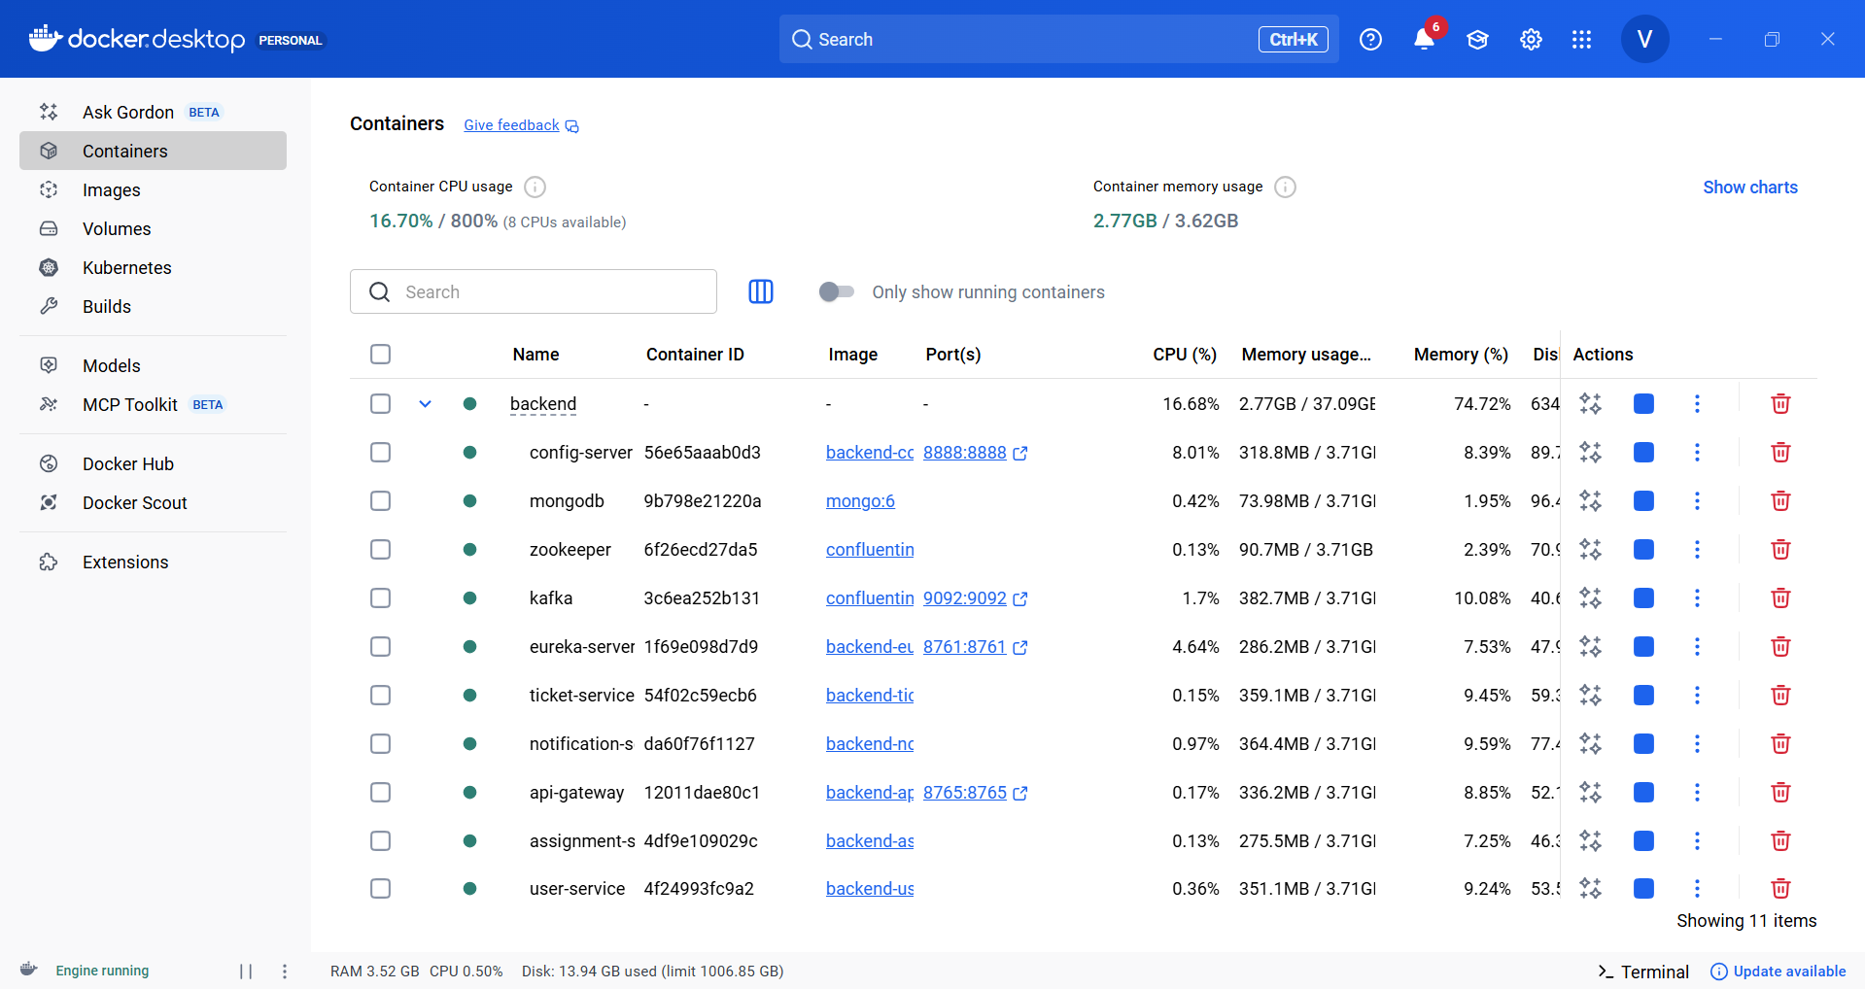
Docker

Slide 50
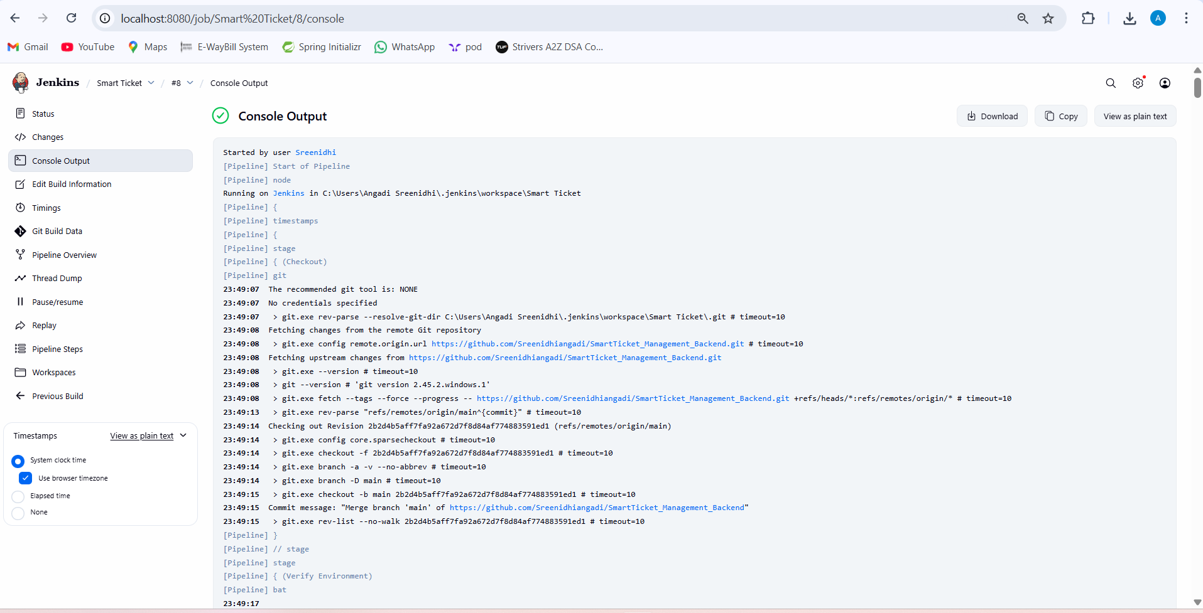
Jenkins

Slide 51


Thank you

